Slide 1
Test Cases for the Mass-Spring-Damper System
Simone Venturi, Tiernan Casey
Extreme-Scale Data Science & Analytics (8739)
Part of the Code Documentation for Neural Networks for Reduced Order Modeling (ROMNet)

Slide 2
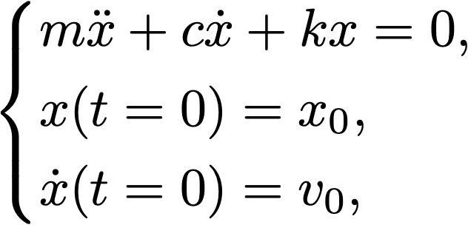
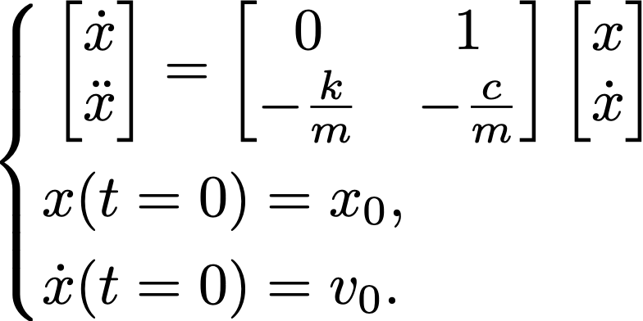
A Mass-Spring-Damper Test Case
Some training scenarios
Initial conditions
Equations of motion:
which can be rewritten as:
The physical system is implemented in
$WORKSPACE_PATH/ROMNet/romnet/romnet/pinn/system/massspringdamper.py
The m, c, and k parameters can be found in
$WORKSPACE_PATH//ROMNet/romnet/database/MassSpringDamper/Params/

Slide 3
A Mass-Spring-Damper Test Case
Run Jupyter Notebook
$WORKSPACE_PATH/ROMNet/romnet/scripts/generating_data/MassSpringDamper/Generate_Data_1.ipynb
for generating training and test data

Slide 4
A Mass-Spring-Damper Test Case
Test Cases 1 & 2

Slide 5
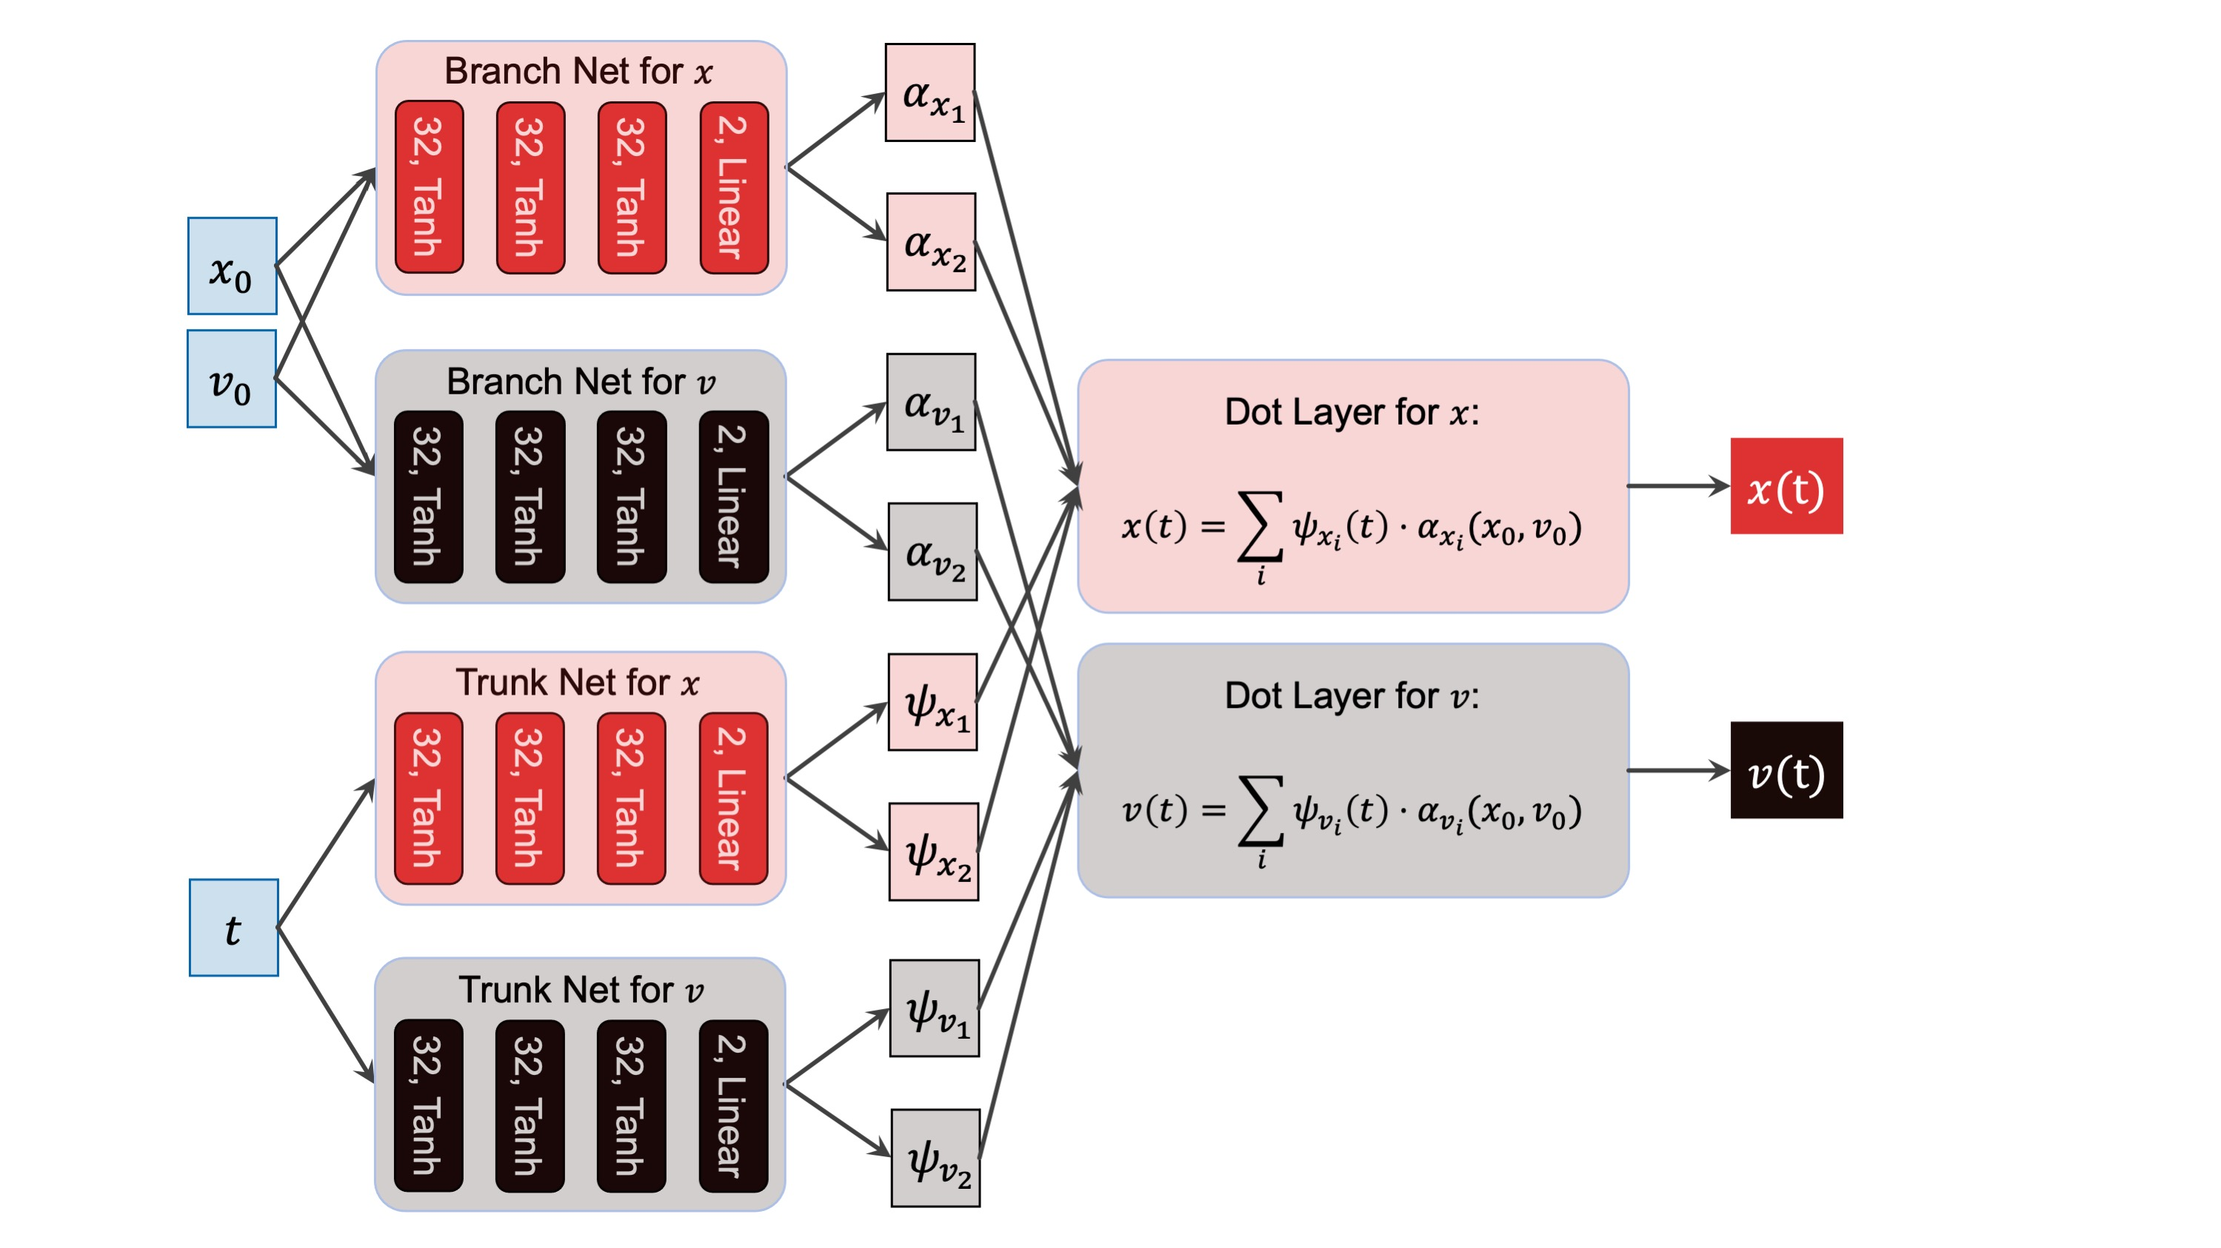
A Mass-Spring-Damper Test Case
DeepONet Structure

Slide 6
A Mass-Spring-Damper Test Case
Test Case 1: Fully data-drive training
Test Case 2: Trained with a physics-informed loss
Test cases
Trunk nets’ outputs (~dynamical modes)

Slide 7
A Mass-Spring-Damper Test Case
Test Case 1: Data-driven deep operator network (DeepONet) for predicting position and velocity
1.1. Copy $WORKSPACE_PATH/ROMNet/romnet/input/MassSpringDamper/DeepONet/TestCase1/ROMNet_Input.py
to $WORKSPACE_PATH/ROMNet/romnet/input/ROMNet_Input.py
1.2. In $WORKSPACE_PATH/ROMNet/romnet/input/ROMNet_Input.py, change:
1.2.1. "self.WORKSPACE_PATH = ..."
1.3. Move to $WORKSPACE_PATH/ROMNet/romnet/app/
1.4. Run: "python3 ROMNet.py ../input/
1.5. Postprocess results via: $WORKSPACE_PATH/ROMNet/romnet/scripts/postprocessing/MassSpringDamper/DeepONet/Predict_DeepONet.ipynb

Slide 8
A Mass-Spring-Damper Test Case
Test Case 2: Physics Informed deep operator network (DeepONet) for predicting position and velocity
2.1. Copy $WORKSPACE_PATH/ROMNet/romnet/input/MassSpringDamper/DeepONet/TestCase2/ROMNet_Input.py
to $WORKSPACE_PATH/ROMNet/romnet/input/ROMNet_Input.py
2.2. In $WORKSPACE_PATH/ROMNet/romnet/input/ROMNet_Input.py, change:
2.2.1. "self.WORKSPACE_PATH = ..."
2.3. Move to $WORKSPACE_PATH/ROMNet/romnet/app/
2.4. Run: "python3 ROMNet.py ../input/”
2.5. Postprocess results via: $WORKSPACE_PATH/ROMNet/romnet/scripts/postprocessing/MassSpringDamper/DeepONet/Predict_DeepONet.ipynb

Slide 9
In the input file:
self. surrogate_type controls the type of surrogate
self.structure is a dictionary that controls the structure of the surrogate
Surrogates:
FNN: Feed-Forward Neural Network
DeepONet: Deep Operator Network
Double_DeepONet: Two DeepONets in Series
System of Components:
FNN
DeepONet
Components:
FNN
Branch
Branch_i
Trunk
Trunk_i
Sub-Components:
Main
U
V
In these test cases:
Branch1
Main
Branch 2
Main
DeepONet
DeepONet
Trunk 1
Main
Trunk 2
Main

Slide 10
The related classes can be found in $WORKSPACE_PATH/ROMNet/romnet/romnet/nn/
Surrogate
System of Components
Output Inverse Normalization Layer
Split Layer
Component
Dot Layer
Multiply Layer
Add Layer
Concatenate Layer
Correlation Layer
Input Normalization Layer
Gaussian Noise Layer
Rigid LayerS
Transformation Layer
Sub_Component
TF Hidden Layer 1
Dropout 1
TF Hidden Layer N
Dropout N
Softmax
input
output
…

Slide 11
The input files for Test Case 1 and 2 differ only for:
self.n_train (i.e. Type/No of Data Points)
'pts’: data point
'ics’: ODE’s initial conditions
'res’: ODE residual
self. losses (i.e., Dictionary Containing Loss Functions for Each Data Type)
self.loss_weights (i.e., Dictionary Containing Weights for Each Data Type)

Slide 12
A Mass-Spring-Damper Test Case
Test Case 3

Slide 13
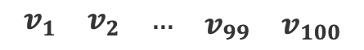
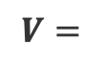
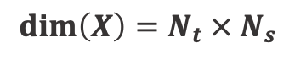
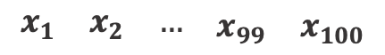
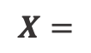
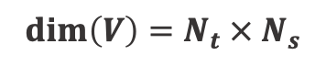
A Mass-Spring-Damper Test Case
A scenario-aggregated principal component analysis (PCA) analogy
By aggregating the training scenarios for $x_{i}\left(t\right)$ and $v_{i}\left(t\right)$, where $i$ represents the scenario index:
$$X=$$
$$\begin{matrix}\begin{matrix}x_{1} & x_{2} & …\end{matrix} & x_{99} & x_{100}\end{matrix}$$
$$V=$$
$$\begin{matrix}\begin{matrix}v_{1} & v_{2} & …\end{matrix} & v_{99} & v_{100}\end{matrix}$$
$$dim\left(X\right)={N_{t} × N}_{s}$$
$$dim\left(V\right)={N_{t} × N}_{s}$$
No of time
instants
No of
scenarios

Slide 14
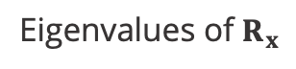
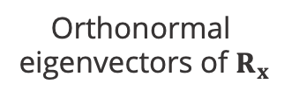

A Mass-Spring-Damper Test Case
Eigenvector Decomposition of the Covariance Matrix of $X$ ($R_{X}=\frac{XX^{T}}{N_{S}−1}$):
Eigenvalues of $R_{x}$
Analyzing the eigenvalues:
$$Λ_{x}=Ψ_{x}^{−1}R_{x}Ψ_{x}$$
Orthonormal
eigenvectors of $R_{x}$
Two principal components ($N_{ψ}=2)$ are sufficient for fully characterizing all the 100 scenarios
Note: Equivalent results obtained for the PCA of $R_{V}$

Slide 15
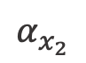
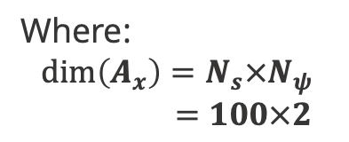
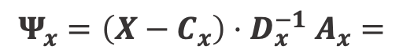
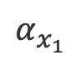
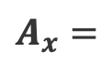
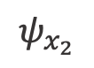

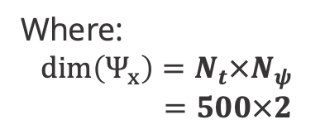
A Mass-Spring-Damper Test Case
Eigenvector Decomposition of the Covariance Matrix of $X$ ($R_{x}=\frac{XX^{T}}{N_{S}−1}$):
Analyzing the modes and
the projection matrix
$$Ψ_{x}={\left(X−C_{x}\right){⋅D}_{x}^{−1}A}_{x}=$$
$$ψ_{x_{1}}$$
$$ψ_{x_{2}}$$
Where:
$$dim\left(Ψ_{x}\right)=N_{t}×N_{ψ}$$
$=500×2$
$$A_{x}=$$
$$α_{x_{1}}$$
$$α_{x_{2}}$$
Where:
$$dim\left(A_{x}\right)=N_{s}×N_{ψ}$$
$=100×2$

Slide 16
A Mass-Spring-Damper Test Case
Run Jupyter Notebook
$WORKSPACE_PATH/ROMNet/romnet/scripts/generating_data/MassSpringDamper/Generate_Data_2.ipynb
for generating PCA training and test data
Note: The script needs to be run twice, the second time after changing mode_name and i_var

Slide 17
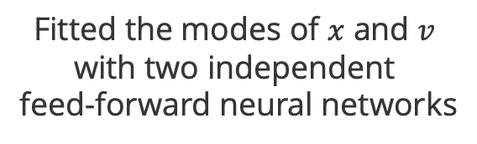
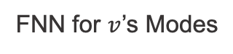
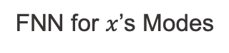


A Mass-Spring-Damper Test Case
FNN for $x$’s Modes
$$t$$
32, Tanh
32, Tanh
32, Tanh
2, Linear
Fitted the modes of $x$ and $v$ with two independent
feed-forward neural networks
FNN for $v$’s Modes
$$t$$
32, Tanh
32, Tanh
32, Tanh
2, Linear

Slide 18
A Mass-Spring-Damper Test Case
Test Case 3: PCA-based interpreation of DeepONets:
Parts I and II: Train Trunks
3.1. Copy $WORKSPACE_PATH/ROMNet/romnet/input/PCA/MassSpringDamper/FNN/Trunk/TestCase3_Part1/ROMNet_Input.py
to $WORKSPACE_PATH/ROMNet/romnet/input/ROMNet_Input.py
3.2. In $WORKSPACE_PATH/ROMNet/romnet/input/ROMNet_Input.py, change:
3.2.1. "self.WORKSPACE_PATH = ..."
3.3. Move to $WORKSPACE_PATH/ROMNet/romnet/app/
3.4. Run: "python3 ROMNet.py ../input/”
3.5. Postprocess results via: $WORKSPACE_PATH/ROMNet/romnet/scripts/postprocessing/PCA/MassSpringDamper/FNN/Predict_FNN_Trunk.ipynb
REPEAT for the second Trunk (i.e., $WORKSPACE_PATH/ROMNet/romnet/input/PCA/MassSpringDamper/FNN/Trunk/TestCase3_Part1/ROMNet_Input.py )

Slide 19

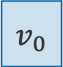

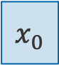
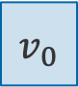
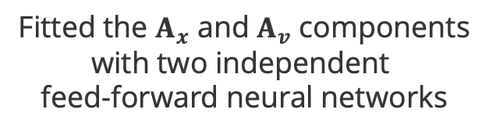
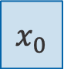
A Mass-Spring-Damper Test Case
$$x_{0}$$
FNN for $A_{x}$’s Coefficients
32, Tanh
32, Tanh
32, Tanh
2, Linear
$$v_{0}$$
Fitted the $A_{x}$ and $A_{v}$ components with two independent
feed-forward neural networks
$$x_{0}$$
FNN for $A_{v}$’s Coefficients
32, Tanh
32, Tanh
32, Tanh
2, Linear
$$v_{0}$$

Slide 20
A Mass-Spring-Damper Test Case
Test Case 3: PCA-based interpreation of DeepONets:
Parts III and IV: Train Branches
3.1. Copy $WORKSPACE_PATH/ROMNet/romnet/input/PCA/MassSpringDamper/FNN/Branch/TestCase3_Part3/ROMNet_Input.py
to $WORKSPACE_PATH/ROMNet/romnet/input/ROMNet_Input.py
3.2. In $WORKSPACE_PATH/ROMNet/romnet/input/ROMNet_Input.py, change:
3.2.1. "self.WORKSPACE_PATH = ..."
3.3. Move to $WORKSPACE_PATH/ROMNet/romnet/app/
3.4. Run: "python3 ROMNet.py ../input/”
3.5. Postprocess results via: $WORKSPACE_PATH/ROMNet/romnet/scripts/postprocessing/PCA/MassSpringDamper/FNN/Predict_FNN_Branch.ipynb
REPEAT for the second Branch (i.e., $WORKSPACE_PATH/ROMNet/romnet/input/PCA/MassSpringDamper/FNN/Branch/TestCase3_Part4/ROMNet_Input.py )

Slide 21

A Mass-Spring-Damper Test Case
Generative DeepONet:
uploaded the parameters of the four FNN’s
as weights and biases of the corresponding trunk and branch nets
and predicted test scenarios (w/o any additional training)

Slide 22
A Mass-Spring-Damper Test Case
Note: If correctly executed, Predict_FNN_Branch.ipynb and Predict_FNN_Trunk.ipynb created the file:
$WORKSPACE_PATH/ROMNet/Data/MSD_100Cases/Orig/OneByOne/FNN/Final.h5,
which contains the trained parameter values for branches and trunk.
Test Case 3: PCA-based interpreation of DeepONets:
Part V: Generate the DeepONet
3.1. Copy $WORKSPACE_PATH/ROMNet/romnet/input/MassSpringDamper/DeepONet/TestCase3_Part5/ROMNet_Input.py
to $WORKSPACE_PATH/ROMNet/romnet/input/ROMNet_Input.py
3.2. In $WORKSPACE_PATH/ROMNet/romnet/input/ROMNet_Input.py, change:
3.2.1. "self.WORKSPACE_PATH = ..."
3.3. Move to $WORKSPACE_PATH/ROMNet/romnet/app/
3.4. Run: "python3 ROMNet.py ../input/”
3.5. Postprocess results via: $WORKSPACE_PATH/ROMNet/romnet/scripts/postprocessing/MassSpringDamper/DeepONet/Predict_DeepONet.ipynb

Slide 23
The input files for Test Case 1 differs from the one of Test Case 3 Part 5 for:
self.path_to_load_fld: we are now including a path for uploading pre-trained weights
self.trainable_flg: we are not training the parameters

Slide 24
A Mass-Spring-Damper Test Case
Test Case 4

Slide 25
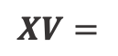
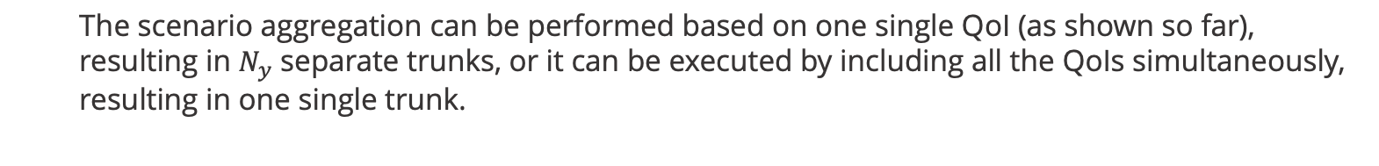

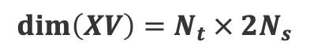
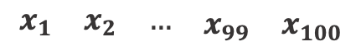
A Mass-Spring-Damper Test Case
The scenario aggregation can be performed based on one single QoI (as shown so far),
resulting in $N_{y}$ separate trunks, or it can be executed by including all the QoIs simultaneously,
resulting in one single trunk.
$$XV=$$
$$\begin{matrix}\begin{matrix}x_{1} & x_{2} & …\end{matrix} & x_{99} & x_{100}\end{matrix}$$
$$\begin{matrix}\begin{matrix}v_{1} & v_{2} & …\end{matrix} & v_{99} & v_{100}\end{matrix}$$
$$dim\left(XV\right)={N_{t} × 2N}_{s}$$

Slide 26
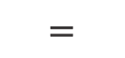
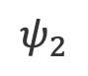
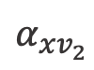
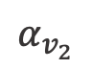
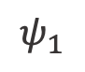
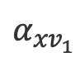
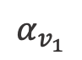
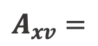
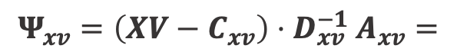
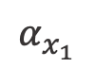
A Mass-Spring-Damper Test Case
$$Ψ_{xv}={\left(XV−C_{xv}\right){⋅D}_{xv}^{−1}A}_{xv}=$$
$$ψ_{1}$$
$$ψ_{2}$$
$$α_{x_{1}}$$
$$α_{x_{2}}$$
$$A_{xv}=$$
$$α_{{xv}_{1}}$$
$$α_{xv_{2}}$$
$$=$$
$$α_{v_{1}}$$
$$α_{v_{2}}$$

Slide 27
A Mass-Spring-Damper Test Case
Run Jupyter Notebook
$WORKSPACE_PATH/ROMNet/romnet/scripts/generating_data/MassSpringDamper/Generate_Data_2_All.ipynb
for generating PCA training and test data

Slide 28
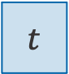
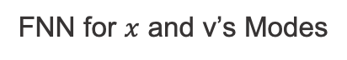
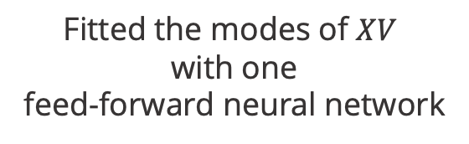
A Mass-Spring-Damper Test Case
FNN for $x$ and v’s Modes
$$t$$
32, Tanh
32, Tanh
32, Tanh
2, Linear
Fitted the modes of $XV$ with one
feed-forward neural network

Slide 29
A Mass-Spring-Damper Test Case
Test Case 4: PCA-based interpreation of DeepONets – Shared Trunk:
Part 1: Train the Trunk
4.1. Copy $WORKSPACE_PATH/ROMNet/romnet/input/PCA/MassSpringDamper/FNN/Trunk/TestCase4_Part1/ROMNet_Input.py
to $WORKSPACE_PATH/ROMNet/romnet/input/ROMNet_Input.py
4.2. In $WORKSPACE_PATH/ROMNet/romnet/input/ROMNet_Input.py, change:
4.2.1. "self.WORKSPACE_PATH = ..."
4.3. Move to $WORKSPACE_PATH/ROMNet/romnet/app/
4.4. Run: "python3 ROMNet.py ../input/”
4.5. Postprocess results via: $WORKSPACE_PATH/ROMNet/romnet/scripts/postprocessing/PCA/MassSpringDamper/FNN/Predict_FNN_Trunk.ipynb

Slide 30

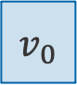

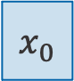
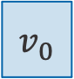
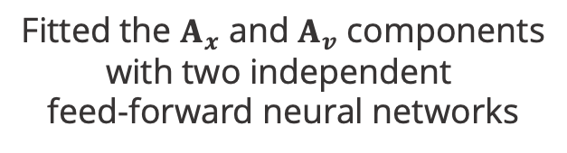
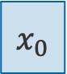
A Mass-Spring-Damper Test Case
$$x_{0}$$
FNN for $A_{x}$’s Coefficients
32, Tanh
32, Tanh
32, Tanh
2, Linear
$$v_{0}$$
Fitted the $A_{x}$ and $A_{v}$ components with two independent
feed-forward neural networks
$$x_{0}$$
FNN for $A_{v}$’s Coefficients
32, Tanh
32, Tanh
32, Tanh
2, Linear
$$v_{0}$$

Slide 31
A Mass-Spring-Damper Test Case
Test Case 4: PCA-based interpreation of DeepONets – Shared Trunk:
Parts II and III: Train Branches
4.1. Copy $WORKSPACE_PATH/ROMNet/romnet/input/PCA/MassSpringDamper/FNN/Branch/TestCase4_Part2/ROMNet_Input.py
to $WORKSPACE_PATH/ROMNet/romnet/input/ROMNet_Input.py
4.2. In $WORKSPACE_PATH/ROMNet/romnet/input/ROMNet_Input.py, change:
4.2.1. "self.WORKSPACE_PATH = ..."
4.3. Move to $WORKSPACE_PATH/ROMNet/romnet/app/
4.4. Run: "python3 ROMNet.py ../input/”
4.5. Postprocess results via: $WORKSPACE_PATH/ROMNet/romnet/scripts/postprocessing/PCA/MassSpringDamper/FNN/Predict_FNN_Branch.ipynb
REPEAT for the second Branch (i.e., $WORKSPACE_PATH/ROMNet/romnet/input/PCA/MassSpringDamper/FNN/Branch/TestCase4_Part3/ROMNet_Input.py )

Slide 32
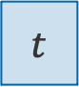
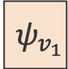














A Mass-Spring-Damper Test Case
FNN for $A_{x}$’s Coeff.s
$$α_{x_{1}}$$
32, Tanh
32, Tanh
32, Tanh
2, Linear
$$x_{0}$$
$$α_{x_{2}}$$
Dot Layer for $x$:
$$x\left(t\right)=\sum_{i}{ψ_{i}\left(t\right)⋅α_{x_{i}}(x_{0},v_{0})}$$
$$v_{0}$$
FNN for $A_{v}$’s Coeff.s
$$α_{v_{1}}$$
$$x(t)$$
32, Tanh
32, Tanh
32, Tanh
2, Linear
$$α_{v_{2}}$$
Dot Layer for $v$:
$$v\left(t\right)=\sum_{i}{ψ_{i}\left(t\right)⋅α_{v_{i}}(x_{0},v_{0})}$$
$$v(t)$$
FNN for $x$ and $v$’s Modes
$$ψ_{v_{1}}$$
$$t$$
32, Tanh
32, Tanh
32, Tanh
2, Linear
$$ψ_{v_{2}}$$
Note: Generative DeepONet
(no training involved)

Slide 33
A Mass-Spring-Damper Test Case
Note: If correctly executed, Predict_FNN_Branch.ipynb and Predict_FNN_Trunk.ipynb created the file:
$WORKSPACE_PATH/ROMNet/Data/MSD_100Cases/Orig/All/FNN/Final.h5,
which contains the trained parameter values for branches and trunk.
Test Case 4: PCA-based interpreation of DeepONets – Shared Trunk:
Part IV: Generate the DeepONet
4.1. Copy $WORKSPACE_PATH/ROMNet/romnet/input/MassSpringDamper/DeepONet/TestCase4_Part4/ROMNet_Input.py
to $WORKSPACE_PATH/ROMNet/romnet/input/ROMNet_Input.py
4.2. In $WORKSPACE_PATH/ROMNet/romnet/input/ROMNet_Input.py, change:
4.2.1. "self.WORKSPACE_PATH = ..."
4.3. Move to $WORKSPACE_PATH/ROMNet/romnet/app/
4.4. Run: "python3 ROMNet.py ../input/”
4.5. Postprocess results via: $WORKSPACE_PATH/ROMNet/romnet/scripts/postprocessing/MassSpringDamper/DeepONet/Predict_DeepONet.ipynb

Slide 34
The input file for Test Case 5 Part 5 differs from the one of Test Case 4 Part 4 for:
self.branch_to_trunk: DeepONet Branch-to-Trunk Type of Mapping ('one_to_one'/'multi_to_one')
Test Case 3 Part 5:
Test Case 4 Part 4:
Branch1
Branch1
Main
Main
Branch 2
Branch 2
Main
Main
DeepONet
DeepONet
DeepONet
DeepONet
Trunk 1
Main
Trunk 1
Main
Trunk 2
Main

